Slide 1
Design Pattern : Memento Name -Rajas Hemant Doshi

Slide 2
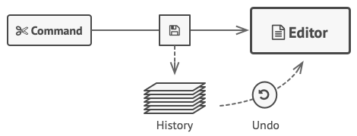
Behavioral Design Patterns: Memento
Save and Restore Object States

Slide 3
Overview
What is Memento?
A design pattern to save and restore the previous state of an object.
Encapsulates state without breaking encapsulation.
Intent: Enable undo/redo functionality in applications without exposing implementation details.
Also Known As: Snapshot

Slide 4
Problem
Scenario:
A text editor with operations like formatting and inserting images.
Requirement: Implement "Undo."
Challenges:
Copying private state details of objects.
Refactoring complexities when state structure changes.
Risk of exposing private states.

Slide 5
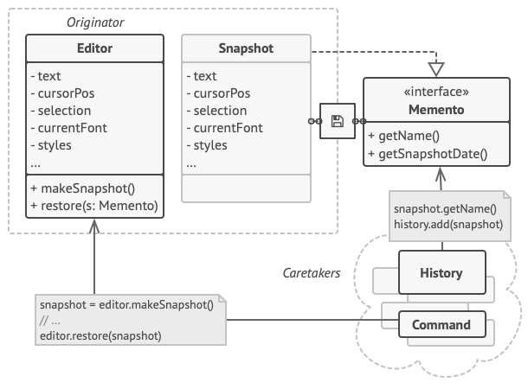
Solution
Key Idea
Delegate state-saving responsibility to the object itself.
Originator: Creates and restores snapshots. Memento: Stores the object's state securely. Caretaker: Manages the memento lifecycle (stores history).
Benefits
Encapsulation remains intact.
Simplifies undo/redo logic.
Components

Slide 6
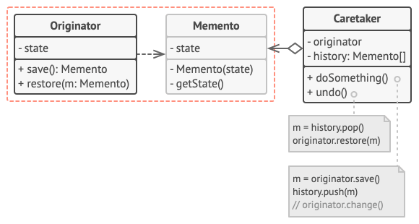
Originator ↔ Memento ↔ Caretaker. Key Relationships: Originator fully accesses Memento. Caretaker uses Memento through a restricted interface.

Slide 7




THANK YOU
(844) 720-6678
info@simplifyhealthcare.com
simplifyhealthcare.com
Simplify Healthcare
U.S.: 600 N Commons Drive, Suite 110, Aurora, IL 60504
India: 401/402, 4th Floor, Pentagon P-2, Magarpatta City, Pune 411013
CONNECT WITH US
LinkedIn
YouTube
X
Instagram

